Slide 1
Domain ML
Technology: Python
FAKE NEWS DETECTION USING MACHINE LEARNING APPROACH

Slide 2
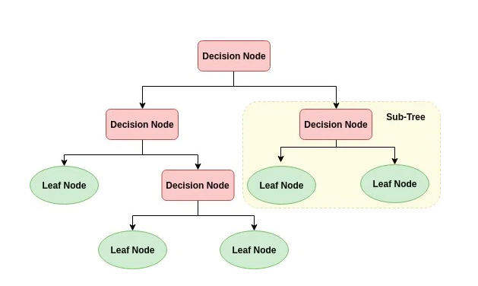
ALGORITHMS
Decision Tree:
Decision tree is a flowchart-like tree structure where an internal node represents feature(or attribute), the branch represents a decision rule, and each leaf node represents the outcome. The topmost node in a decision tree is known as the root node. It learns to partition on the basis of the attribute value. It partitions the tree in recursively manner call recursive partitioning. This flowchart-like structure helps you in decision making. It's visualization like a flowchart diagram which easily mimics the human level thinking. That is why decision trees are easy to understand and interpret.

Slide 3
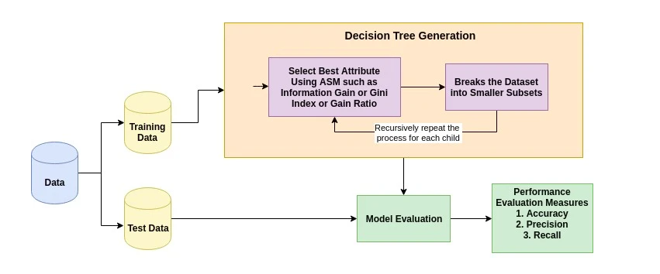
The basic idea behind any decision tree algorithm is as follows:
Select the best attribute using Attribute Selection Measures (ASM) to split the records.
Make that attribute a decision node and breaks the dataset into smaller subsets.
Starts tree building by repeating this process recursively for each child until one of the conditions will match:
All the tuples belong to the same attribute value.
There are no more remaining attributes.
There are no more instances.

Slide 4
2. XGBOOST:
XGBoost stands for “Extreme Gradient Boosting”. XGBoost is an optimized distributed gradient boosting library designed to be highly efficient, flexible and portable. It implements Machine Learning algorithms under the Gradient Boosting framework. It provides a parallel tree boosting to solve many data science problems in a fast and accurate way.
Boosting
Boosting is an ensemble learning technique to build a strong classifier from several weak classifiers in series. Boosting algorithms play a crucial role in dealing with bias-variance trade-off. Unlike bagging algorithms, which only controls for high variance in a model, boosting controls both the aspects (bias & variance) and is considered to be more effective XGBoost stands for eXtreme Gradient Boosting. It became popular in the recent days and is dominating applied machine learning and Kaggle competitions for structured data because of its scalability.

Slide 5
3. RANDOM FOREST CLASSIFIER:
A random forest is a machine learning technique that’s used to solve regression and classification problems. It utilizes ensemble learning, which is a technique that combines many classifiers to provide solutions to complex problems.
A random forest algorithm consists of many decision trees. The ‘forest’ generated by the random forest algorithm is trained through bagging or bootstrap aggregating. Bagging is an ensemble meta-algorithm that improves the accuracy of machine learning algorithms.
The (random forest) algorithm establishes the outcome based on the predictions of the decision trees. It predicts by taking the average or mean of the output from various trees. Increasing the number of trees increases the precision of the outcome.
A random forest eradicates the limitations of a decision tree algorithm. It reduces the over fitting of datasets and increases precision. It generates predictions without requiring many configurations in packages (like Scikit-learn).

Slide 6
Features of a Random Forest Algorithm:
It’s more accurate than the decision tree algorithm.
It provides an effective way of handling missing data.
It can produce a reasonable prediction without hyper-parameter tuning.
It solves the issue of over fitting in decision trees.
In every random forest tree, a subset of features is selected randomly at the node’s splitting point.
Decision trees are the building blocks of a random forest algorithm. A decision tree is a decision support technique that forms a tree-like structure. An overview of decision trees will help us understand how random forest algorithms work.
A decision tree consists of three components: decision nodes, leaf nodes, and a root node. A decision tree algorithm divides a training dataset into branches, which further segregate into other branches. This sequence continues until a leaf node is attained. The leaf node cannot be segregated further.
The nodes in the decision tree represent attributes that are used for predicting the outcome. Decision nodes provide a link to the leaves. The following diagram shows the three types of nodes in a decision tree.

Slide 7
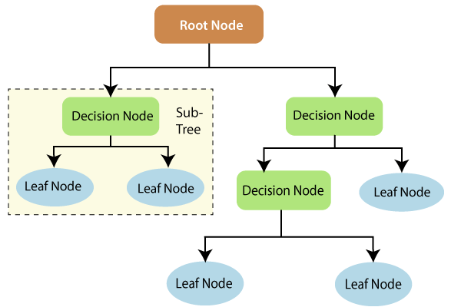
The information theory can provide more information on how decision trees work. Entropy and information gain are the building blocks of decision trees. An overview of these fundamental concepts will improve our understanding of how decision trees are built.
Entropy is a metric for calculating uncertainty. Information gain is a measure of how uncertainty in the target variable is reduced, given a set of independent variables.
The information gain concept involves using independent variables (features) to gain information about a target variable (class). The entropy of the target variable (Y) and the conditional entropy of Y (given X) are used to estimate the information gain. In this case, the conditional entropy is subtracted from the entropy of Y.

Slide 8
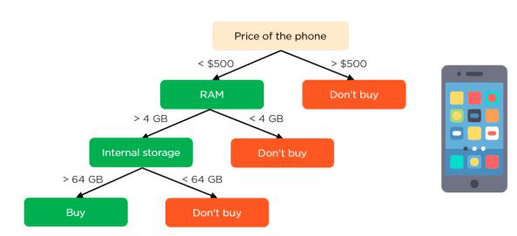
Information gain is used in the training of decision trees. It helps in reducing uncertainty in these trees. A high information gain means that a high degree of uncertainty (information entropy) has been removed. Entropy and information gain are important in splitting branches, which is an important activity in the construction of decision trees.
Let’s take a simple example of how a decision tree works. Suppose we want to predict if a customer will purchase a mobile phone or not. The features of the phone form the basis of his decision. This analysis can be presented in a decision tree diagram.
The root node and decision nodes of the decision represent the features of the phone mentioned above. The leaf node represents the final output, either buying or not buying. The main features

Slide 9
HARDWARE AND SOFTWARE REQUIREMENTS
H/W Configuration:
Operating system : Windows 7 or 7+
RAM : 8 GB
Hard disc or SSD : More than 500 GB
Processor : Intel 3rd generation or high or Ryzen with 8 GB Ram
S/W Configuration:
Software’s : Python 3.6 or high version
IDE : PyCharm.
Framework : Flask

Slide 10

OUTPUT SCREEN SHOTS WITH DESCRIPTION.
Home Page:
Here user view the home page of fake news detection web application.

Slide 11

ABOUT:
Here we can read about our project.

Slide 12
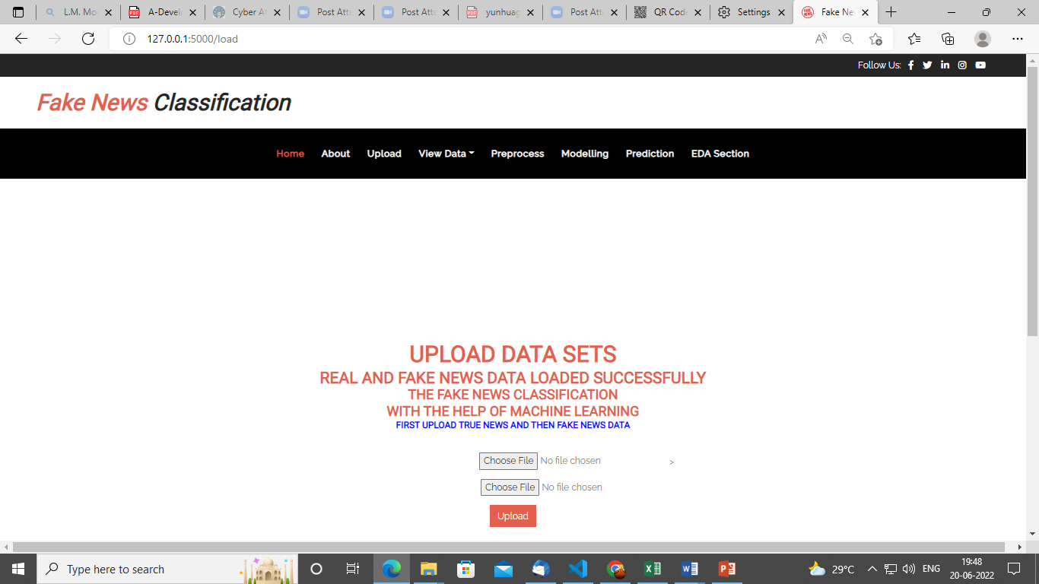
Load:
In the load page, users can load the news dataset.

Slide 13
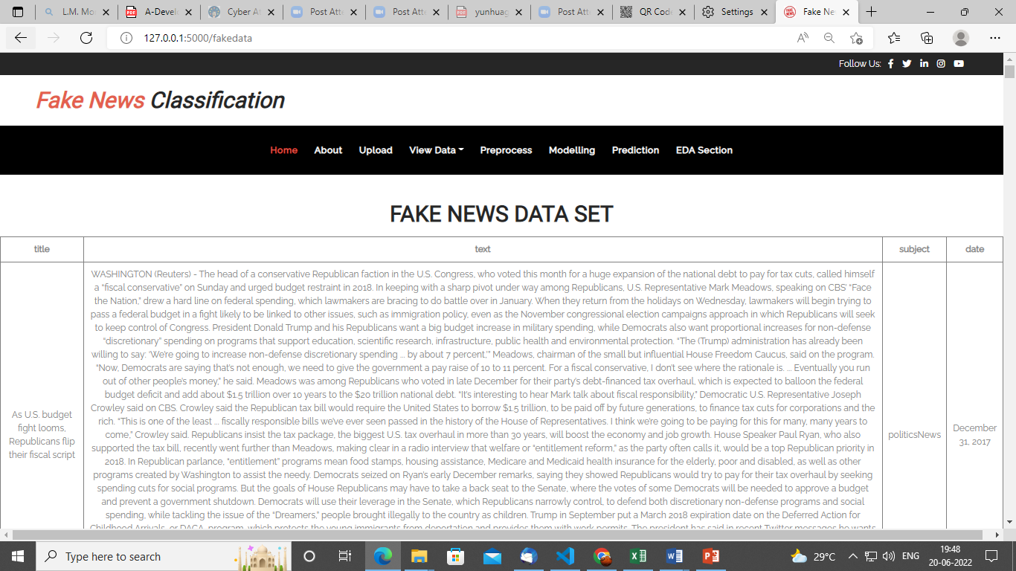
View:
Here we can see the uploaded data set.

Slide 14
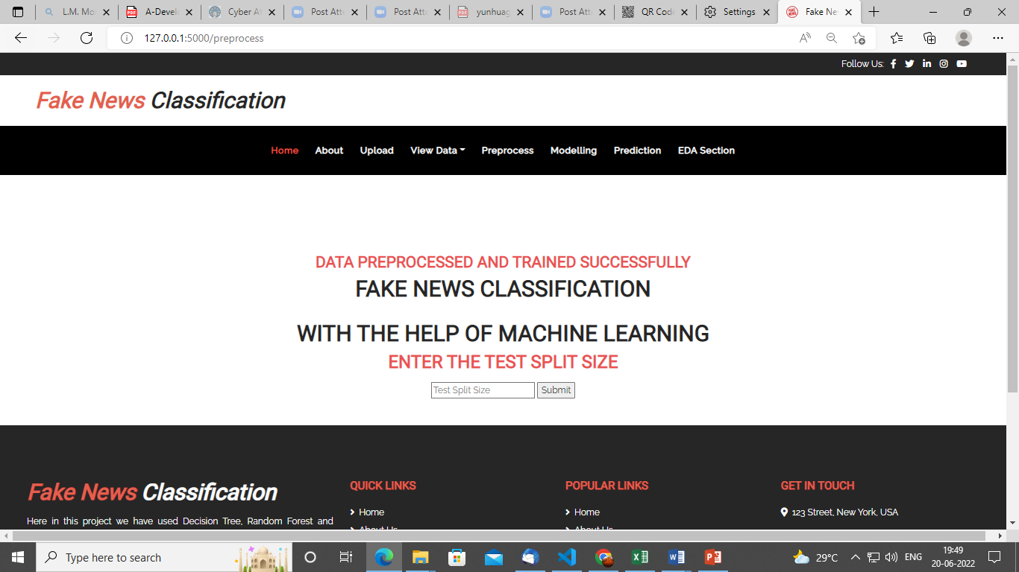
Pre-processing:
Here we can split our data into train and test.

Slide 15
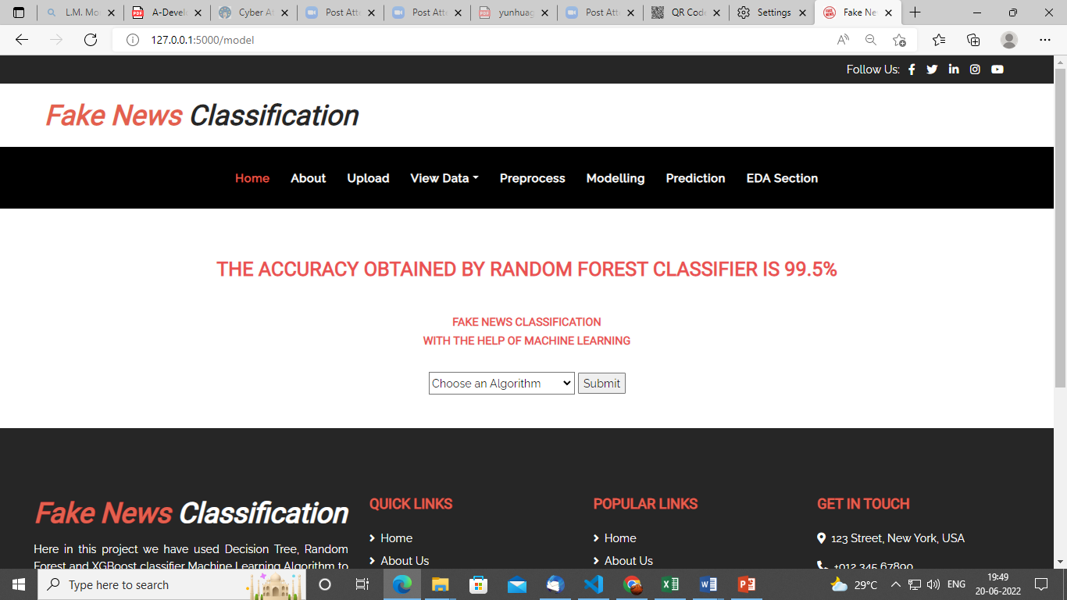
Model:
Here we can train our data using different algorithm.

Slide 16
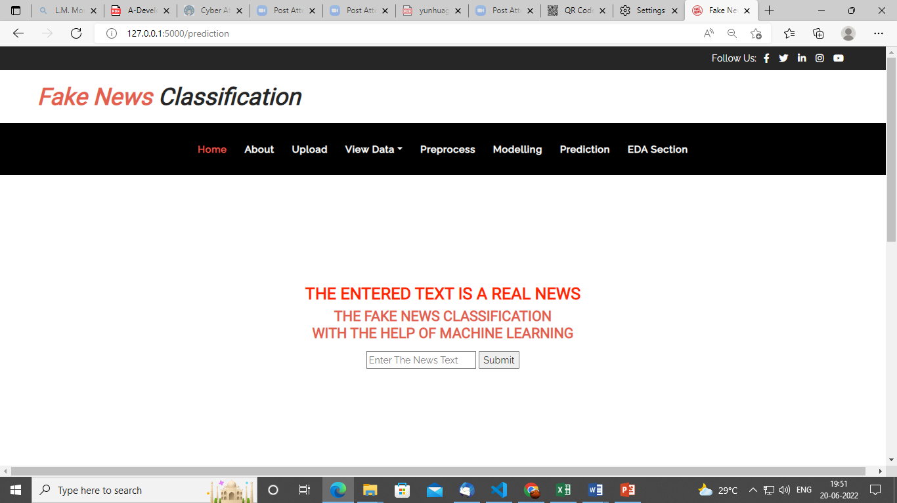
Prediction:
This page show the detection result of the thyroid disease data.

Slide 17


